Slide 1
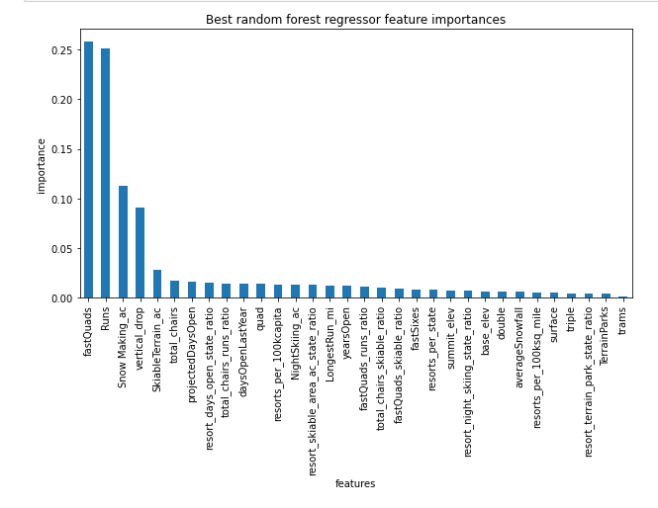
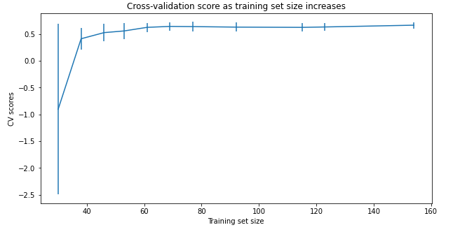
Guided Capstone Project Report
After data cleaning and data wrangling, several regression models and folds were tried. The random forest model gave the best R-sq fit of 0.62 on training data
and 0.79 on test data.
Based on random forest model, Big Mountain Resort modelled price is 95.87 where in the current ticket price is 81.00. Among all the options that the management want to pursue,
the most beneficial is adding a vertical drop of 150 feet and adding a chair car. The ticket price can be increased 8.61 to cover for the additional operating cost.
However, resulting increase in revenue is predicted to be >15 million.
Cross-validation shows CV scores level off at 50-60 sample size
The four dominant features were found to be 1. fastQuad, 2 Runs, 3. snow_making_ac, 4.vertical_drop

Slide 2
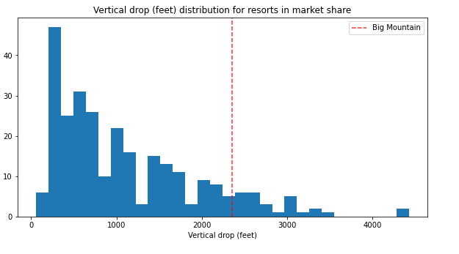
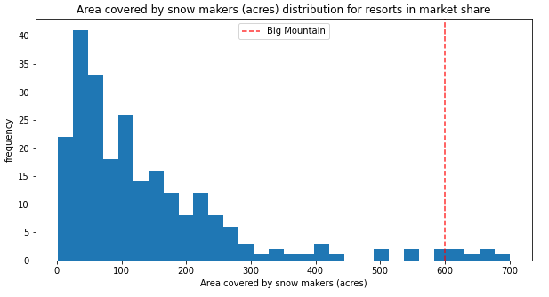
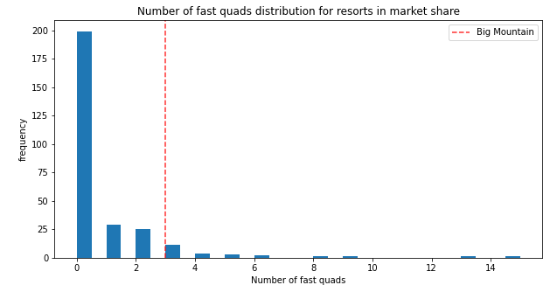
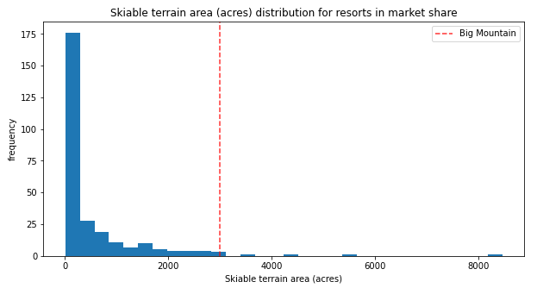
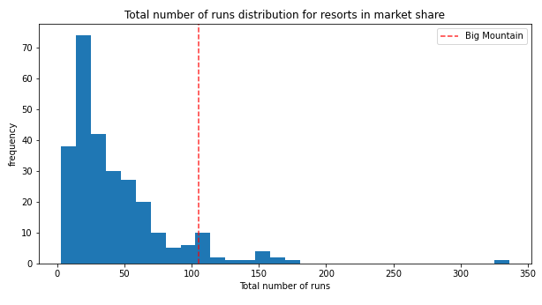
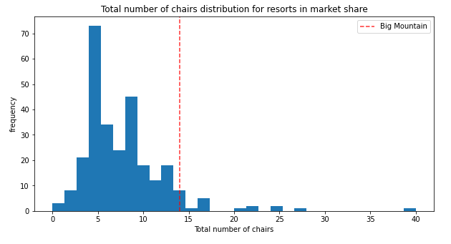
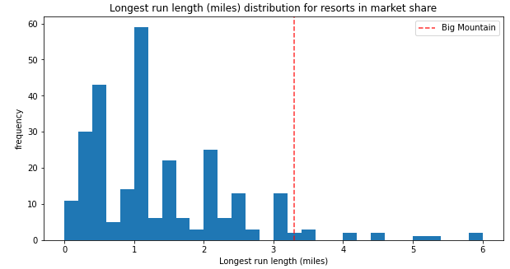
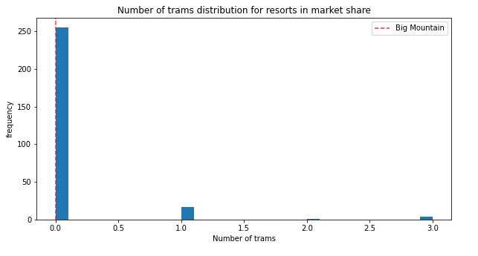
Big mountain fares very well on most relevant factors except trams.

Slide 3
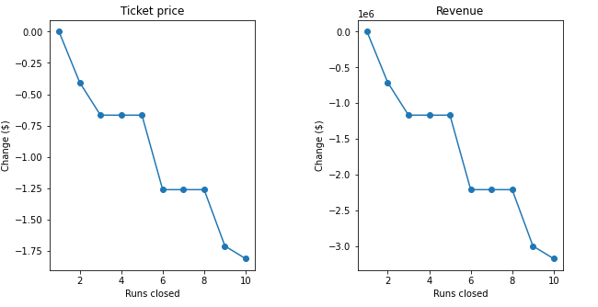
Closing one run does not make a difference with respect to predicted ticket price and revenue. However, closing total runs by 3 will reduce ticket price and revenue both.

